Slide 1
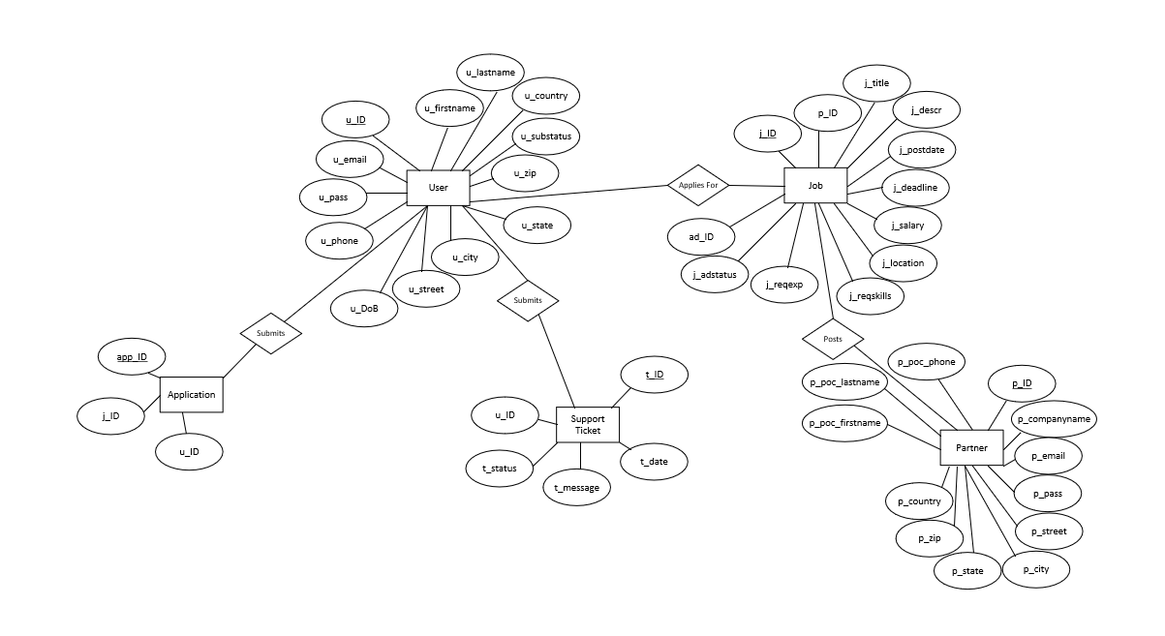
Conceptual ER Diagram
Team 1
Jobster

Slide 2
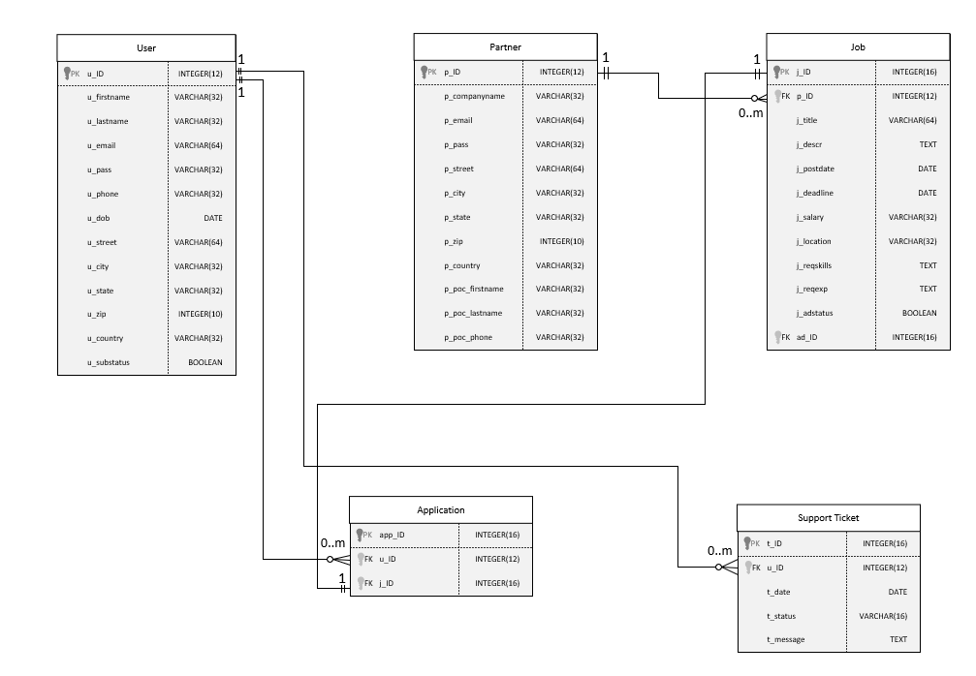
Logical ER Diagram
Team 1
Jobster

